Slide 1
Introduction to Python: Get Started
Kamran Khan

Slide 2
What is Python?
“Python is a widely used high-level, interpreted programming language for general-purpose programming, created by Guido van Rossum and first released in 1991. “ –Wikipedia
Version:
2.7.x
3.5.x
Notes:
What python is and why it used
How we setup the environment using Jupyter notebook

Slide 3
Why Python?
High-level
No type declaration for variables, methods, or parameters
Enforces a strict coding style ( which allows it to be extremely readable)
Object oriented
Cross platform
Notes:
Because of that, most of the things that we will do will become easiser

Slide 4
Why Python? – Cont’D
Has a thriving community of contributors and third party application developers
The python package index (PyPI) hosts thousands of third-party modules.
Notes:
Most pacakges are open source.

Slide 5
Applications: Web Development
Frameworks such as Django and Pyramid
Python’s standard library supports: HTML, XML, JSON, FTP, IMAP, etc.
BeautifulSoup: HTML parser that can handle all sorts of HTML
FeedParser: parsing RSS/Atom Feeds
Notes:
Easily build web appications with less code
Internet protcols
Unicode utfe

Slide 6
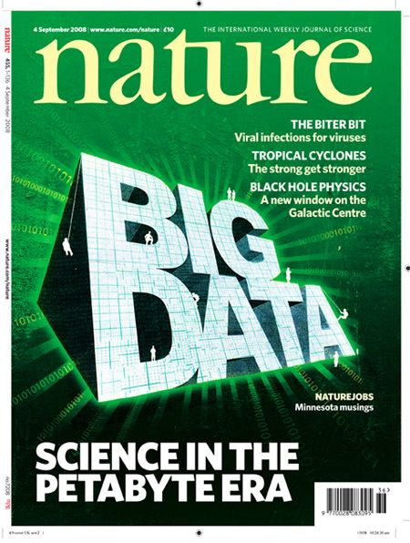
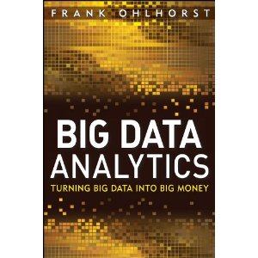
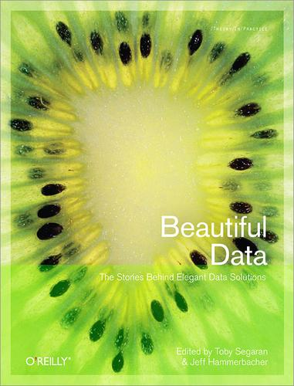

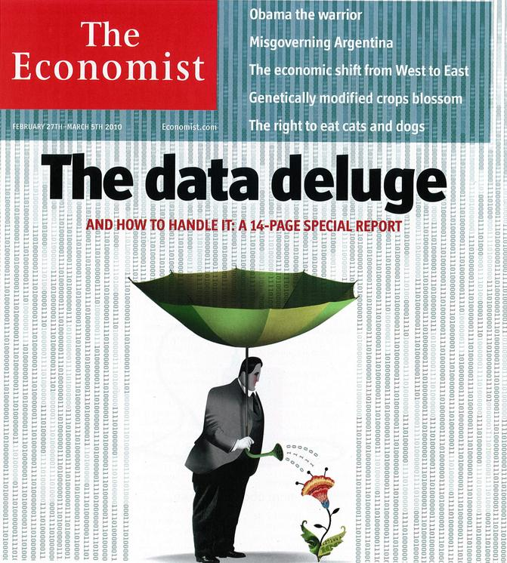
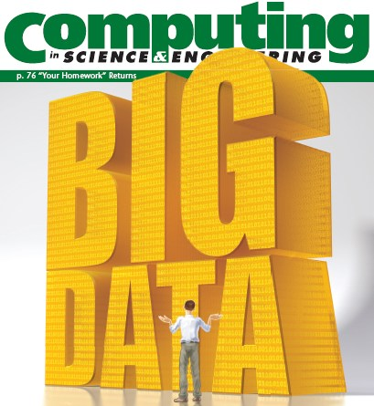

“It’s a great time to be a data geek.”
-- Roger Barga, Microsoft Research
“The greatest minds of my generation are trying
to figure out how to make people click on ads”
-- Jeff Hammerbacher, co-founder, Cloudera

Slide 7
All of science is reducing to computational data manipulation
Old model: “Query the world” (Data acquisition coupled to a specific hypothesis)
New model: “Download the world” (Data acquisition supports many hypotheses)
Astronomy: High-resolution, high-frequency sky surveys (SDSS, LSST, PanSTARRS)
Biology: lab automation, high-throughput sequencing,
Oceanography: high-resolution models, cheap sensors, satellites
40TB / 2 nights
Slide from Bill Howe, eScience Institute

Slide 8
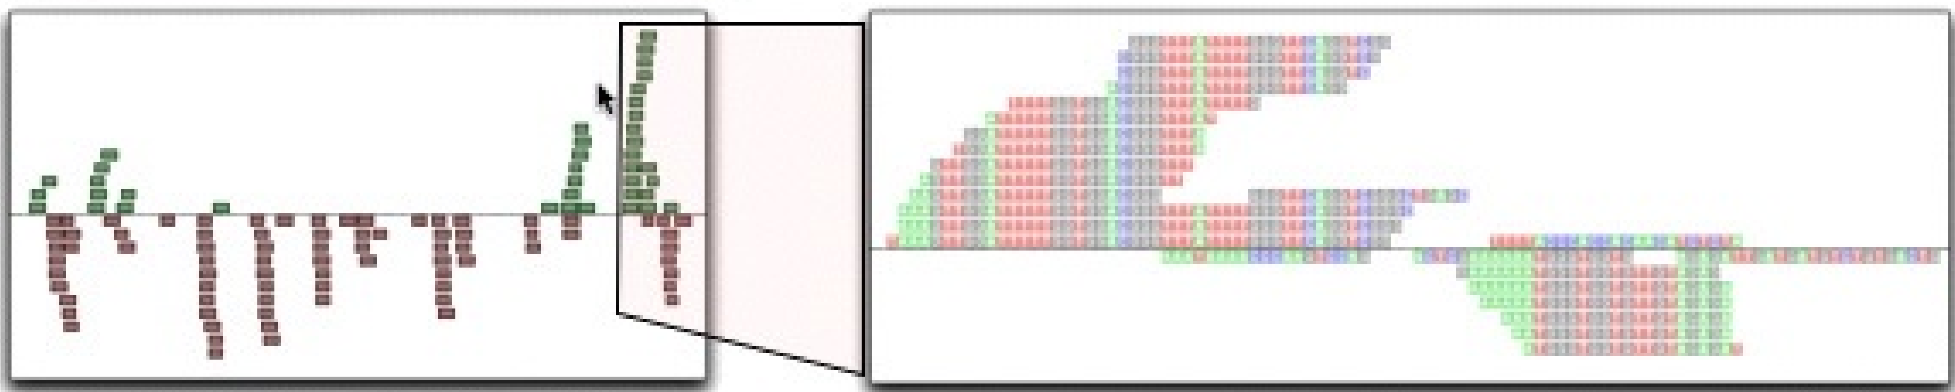

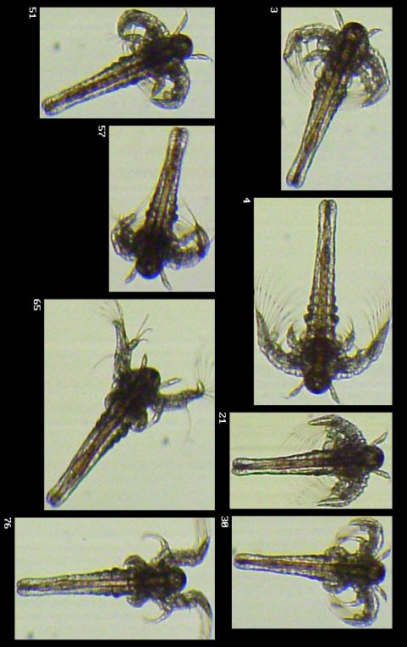
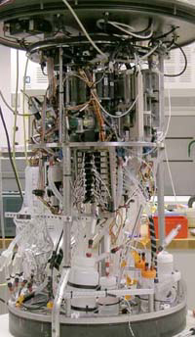
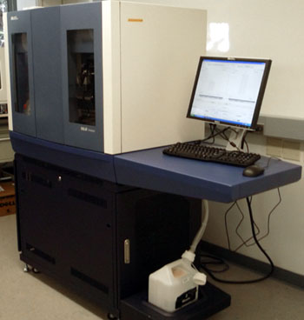

40TB / 2 nights
~1TB / day
100s of devices
Slide from Bill Howe, eScience Institute
Notes:
Slide from Bill Howe, eScience Institute, his notes:
Drowning in data; starving for information
We’re at war with these engineering companies. FlowCAM is bragging about the amount of data they can spray out of their device. How to use this enormous data stream to answer scientific questions is someone else’s problem.
“Typical large pharmas today are generating 20 terabytes of data daily. That’s probably going up to 100 terabytes per day in the next year or so.”
“tens of terabytes of data per day” -- genome center at Washignton University
Increase data collection exponentially with flowcam

Slide 9
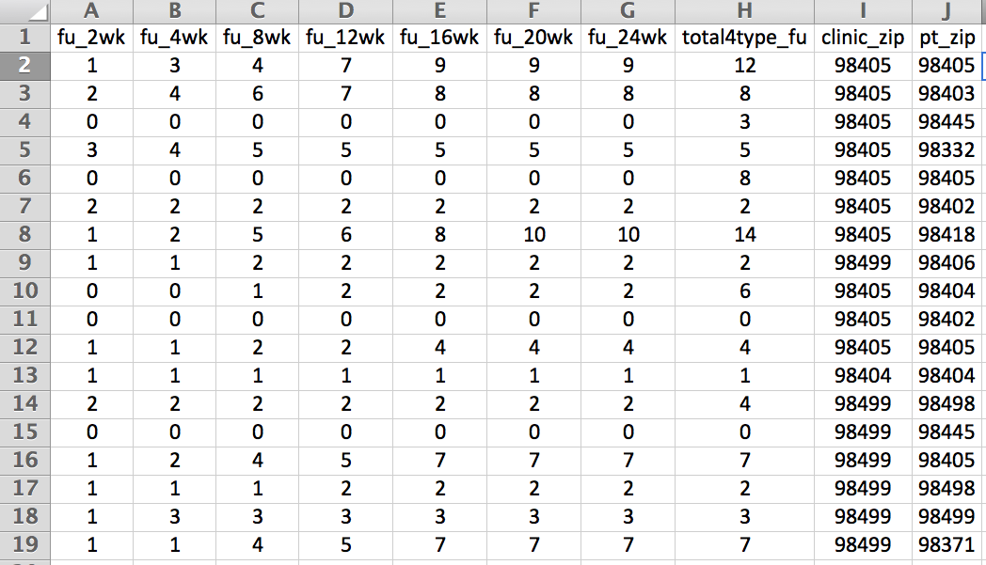
Example: Assessing treatment efficacy
number of follow ups within 16 weeks after treatment enrollment.
Zip code of clinic
Zip code of patient
Question: Does the distance between the patient’s home and clinic influence the number of follow ups, and therefore treatment efficacy?

Slide 10
Python program to assess treatment efficacy
# This program reads an Excel spreadsheet whose penultimate
# and antepenultimate columns are zip codes.
# It adds a new last column for the distance between those zip
# codes, and outputs in CSV (comma-separated values) format.
# Call the program with two numeric values: the first and last
# row to include.
# The output contains the column headers and those rows.
# Libraries to use
import random
import sys
import xlrd # library for working with Excel spreadsheets
import time
from gdapi import GoogleDirections
# No key needed if few queries
gd = GoogleDirections('dummy-Google-key')
wb = xlrd.open_workbook('mhip_zip_eScience_121611a.xls')
sheet = wb.sheet_by_index(0)
# User input: first row to process, first row not to process
first_row = max(int(sys.argv[1]), 2)
row_limit = min(int(sys.argv[2]+1), sheet.nrows)
def comma_separated(lst):
return ",".join([str(s) for s in lst])
headers = sheet.row_values(0) + ["distance"]
print comma_separated(headers)
for rownum in range(first_row,row_limit):
row = sheet.row_values(rownum)
(zip1, zip2) = row[-3:-1]
if zip1 and zip2:
# Clean the data
zip1 = str(int(zip1))
zip2 = str(int(zip2))
row[-3:-1] = [zip1, zip2]
# Compute the distance via Google Maps
try:
distance = gd.query(zip1,zip2).distance
except:
print >> sys.stderr, "Error computing distance:", zip1, zip2
distance = ""
# Print the row with the distance
print comma_separated(row + [distance])
# Avoid too many Google queries in rapid succession
time.sleep(random.random()+0.5)
23 lines of executable code!

Slide 11
Applications: Science And Numeric Computing
Numpy: fundamental package for scientific computing
SciPy: collection of packages for mathematics, science, and engineering
Pandas: data analysis and modeling library
OpenCV: image processing and computer vision
Python Image Library: image processing
Matplotlib: plotting
Notes:
Varius capabilities such linear algebra, fourier transform, Random number generation
Publication qulity figures

Slide 12
Applications: Science And Numeric Computing
Scikit-learn: machine learning
PyDoop: python interface to Hadoop
Notes:
Map-reduce applications in interative hpfs using pure python
Big data and distributed data environment

Slide 13
Applications: GUI Building
wxWidget: GUI toolkit
Pyqt: GUI toolkit
Others:
PyGame: 2D
Pyglet: 3D
Nose: testing framework

Slide 14
Python: Installation

Slide 15
Installation
Mac OS X and Linux comes pre installed with python. Windows users can download python from https://www.python.org/downloads/ .
To install IPython run,
$ pip install ipython[all]
This will install all the necessary dependencies for the notebook, qtconsole, tests etc.

Slide 16
Installation from unofficial distributions
Installing all the necessary libraries might prove troublesome. Anaconda and Canopy comes pre packaged with all the necessary python libraries and also IPython.
Anaconda
Download Anaconda from https://www.continuum.io/downloads
Anaconda is completely free and includes more than 300 python packages. Both python 2.7 and 3.4 options are available.
Canopy
Download Canopy from https://store.enthought.com/downloads/#default
Canopy has a premium version which offers 300+ python packages. But the free version works just fine. Canopy as of now supports only 2.7 but it comes with its own text editor and IPython environment.

Slide 17
Environment: Jupyter (Ipython Notebook)
https://www.continuum.io/downloads
“The Jupyter Notebook is a web application allows you to create and share documents that contain live code, equations, visualizations and explanatory text.
Uses include: data cleaning and transformation, numerical simulation, statistical modeling, machine learning and much more”
Notes:
Anaconda is the leading open data science platform powered by Python.
The open source version of Anaconda is a high performance distribution of Python and R and includes over 100 of the most popular Python, R and Scala packages for data science.

Slide 18
Python: Files

Slide 19
files
Extension: files end in .py
Not strictly required
e.g. script.py
Execution:
CANOPY: play button
IPython: run script.py
Python terminal: python script.py

Slide 20
Python: Syntax

Slide 21
Indentation
Most languages don’t care about indentation
Most humans do

Slide 22
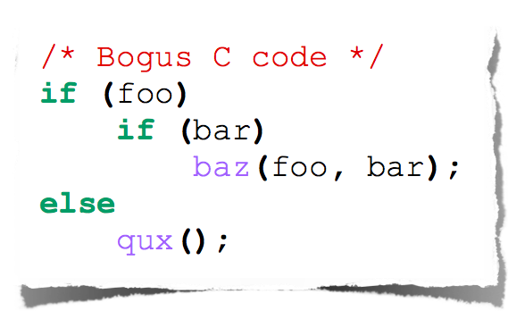
Indentation
The else here actually belongs to the 2nd if statement

Slide 23
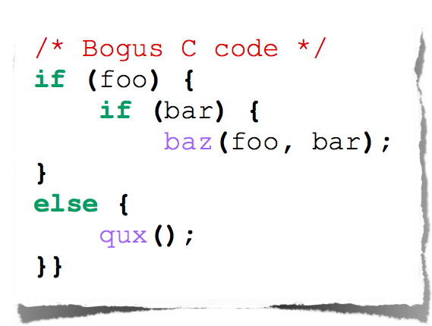
Indentation
The else here actually belongs to the 2nd if statement

Slide 24
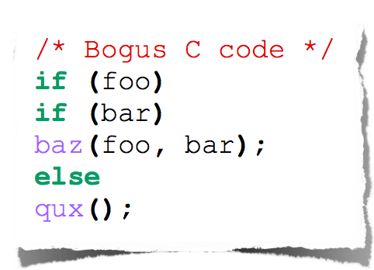
Indentation
I knew a coder like this

Slide 25
Indentation
The else here actually belongs to the 2nd if statement

Slide 26
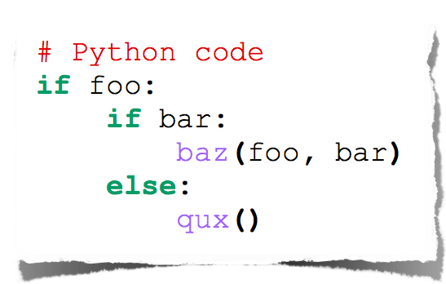
Indentation
Python embraces indentation

Slide 27
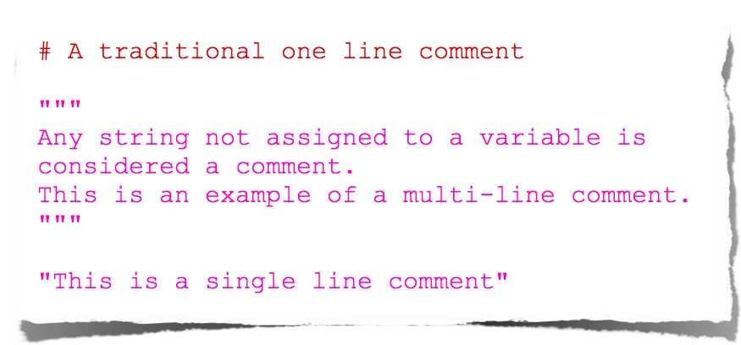
Comments
Python embraces indentation

Slide 28
Python: Variables

Slide 29
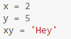
Variable: A name that is used to denote something or a value is called a variable. In python, variables can be declared and values can be assigned to it as follows,

Slide 30
Python: Data Type

Slide 31
Python has all the data types one deserves as a programmer:
Numbers (int, float, long)
Strings (str)
Arrays (list, tuple)
Sets (set)
Hashes: key-value pairs (dict)
A special dict (defaultdict)
Counters (Counter)

Slide 32
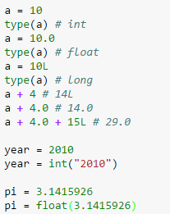
Numbers

Slide 33
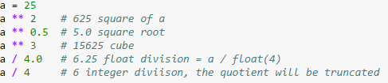
Numbers – Cont’d
Note: if the numerator or denominator is a float, then quotient will be a float

Slide 34
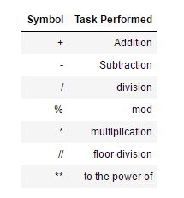
Numbers – Cont’d

Slide 35
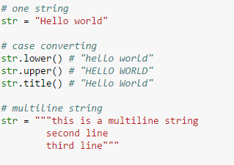
Strings

Slide 36
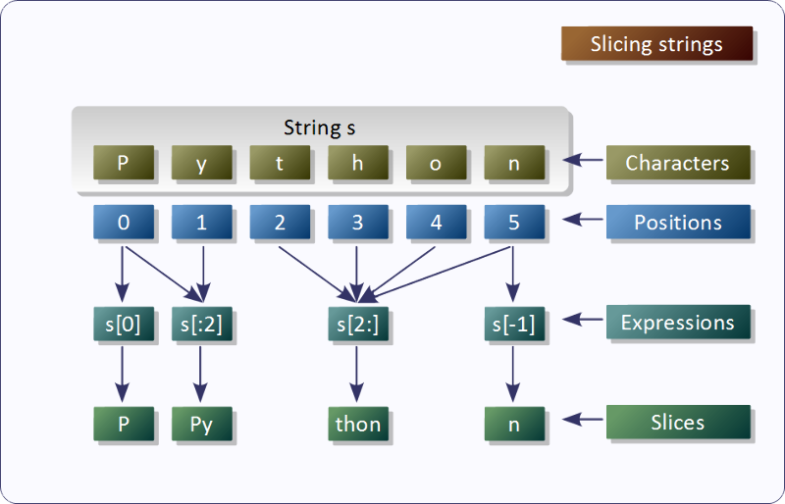

Slide 37
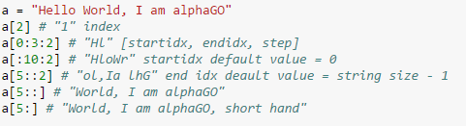
Strings – Cont’d
Python strings are arrays, it can be processed through slicing, just like lists

Slide 38
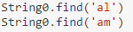
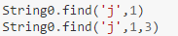
Strings – find( )
function returns the index value of the given data that is to found in the string. If it is not found it returns -1. Remember to not confuse the returned -1 for reverse indexing value.
replace( ) function replaces the element with another element.

Slide 39
Strings – capitalize( )
is used to capitalize the first element in the string.

Slide 40
Strings – center( )
is used to center align the string by specifying the field width.

Slide 41
Strings – zfill( )
is used for zero padding by specifying the field width.

Slide 42
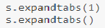
Strings – expandtabs( )
allows you to change the spacing of the tab character. '\t' which is by default set to 8 spaces.

Slide 43
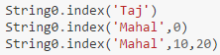
Strings – index( )
works the same way as find( ) function the only difference is find returns '-1' when the input element is not found in the string but index( ) function throws a ValueError

Slide 44
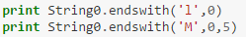
Strings – endswith( )
function is used to check if the given string ends with the particular char which is given as input.

Slide 45
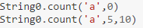
Strings – count( ) function counts the number of char in the given string. The start and the stop index can also be specified or left blank. (These are Implicit arguments which will be dealt in functions)

Slide 46
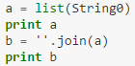
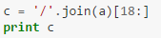
Strings – join( ) function is used add a char in between the elements of the input string.
join( ) function can also be used to convert a list into a string.
Before converting it into a string join( ) function can be used to insert any char in between the list elements.

Slide 47
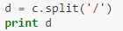
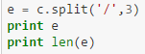
Strings – split( ) function is used to convert a string back to a list. Think of it as the opposite of the join() function.

Slide 48
Strings – strip( ) function is used to delete elements from the right end and the left end which is not required.

Slide 49
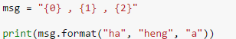
Strings- The operator % is used for string interpolation. The interpolation is more efficient in use of memory than the conventional concatenation.
Symbols used in the interpolation:
%s: string.
%d: integer.
%o: octal.
%x: hexacimal.
%f: real.
%e: real exponential.
%%: percent sign.

Slide 50
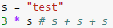
Strings-operators

Slide 51
Lists (array)
Lists are collections of heterogeneous objects, which can be of any type, including other lists.
Syntax:
list = [a, b, ..., z]

Slide 52
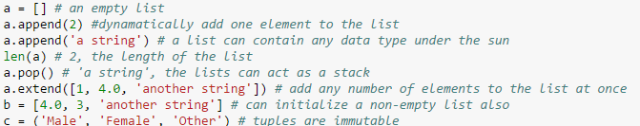
Lists (array)

Slide 53
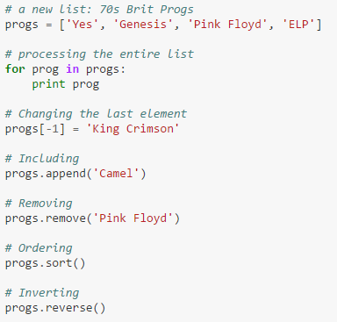
Lists (array)

Slide 54

Python: Control Flow
Making decisions

Slide 55
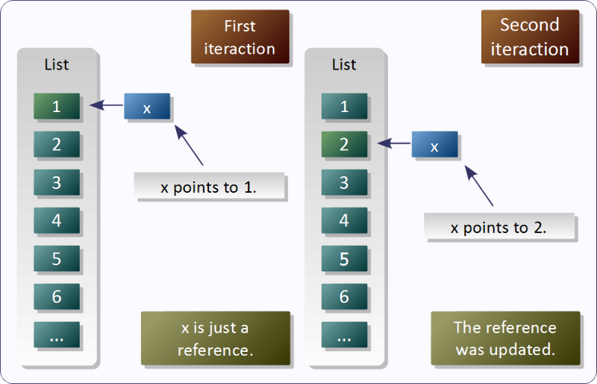

Slide 56
Temperature conversion chart
fahr = 30
cent = (fahr - 32) / 9.0 * 5
print fahr, cent
fahr = 40
cent = (fahr - 32) / 9.0 * 5
print fahr, cent
fahr = 50
cent = (fahr - 32) / 9.0 * 5
print fahr, cent
fahr = 60
cent = (fahr - 32) / 9.0 * 5
print fahr, cent
fahr = 70
cent = (fahr - 32) / 9.0 * 5
print fahr, cent
print "All done"
Output:
30 -1.11
40 4.44
50 10.0
60 15.56
70 21.11
All done

Slide 57
A better way to repeat yourself:
loop variable or
iteration variable
Colon is required
for loop
A list
Loop body is indented
for f in [30,40,50,60,70]:
print f, (f-32)/9.0*5
print "All done"
Execute the body 5 times:
once with f = 30
once with f = 40
…
Output:
30 -1.11
40 4.44
50 10.0
60 15.56
70 21.11
All done
Indentation is significant

Slide 58
Idea: convert a for loop into something we know how to execute
Evaluate the sequence expression
Write an assignment to the loop variable, for each sequence element
Write a copy of the loop after each assignment
Execute the resulting statements
State of the computer:
Printed output:
i = 1
print i
i = 4
print i
i = 9
print i
for i in [1,4,9]:
print i
1
4
9
i: 1
i: 4
i: 9

Slide 59
Evaluate the sequence expression
While there are sequence elements left:
Assign the loop variable to the next remaining sequence element
Execute the loop body
State of the computer:
Current location in list
Printed output:
for i in [1,4,9]:
print i
1
4
9
i: 1
i: 4
i: 9

Slide 60
Execute whole body, then execute whole body again, etc.
for i in [3,4,5]:
print "Start body"
print i
print i*i
Convention: often use i or j as loop variable if values are integers
This is an exception to the rule that variable names should be descriptive
loop body: 3 statements

Slide 61
Execute whole body, then execute whole body again, etc.
for i in [3,4,5]:
print "Start body"
print i
print i*i
Convention: often use i or j as loop variable if values are integers
This is an exception to the rule that variable names should be descriptive
Output:
Start body
3
9
Start body
4
16
Start body
5
25
NOT:
Start body
Start body
Start body
3
4
5
9
16
25
loop body: 3 statements

Slide 62
Indentation is significant
Every statement in the body must have exactly the same indentation
That’s how Python knows where the body ends
for i in [3,4,5]:
print "Start body"
print i
print i*i
Compare the results of these loops:
for f in [30,40,50,60,70]:
print f, (f-32)/9.0*5
print "All done"
for f in [30,40,50,60,70]:
print f, (f-32)/9.0*5
print "All done"
Error!
Notes:
You can tell what this means, but the computer cannot

Slide 63
Nested Loops
How many statements does this loop contain?
for i in [0,1]:
print "Outer", i
for j in [2,3]:
print " Inner", j
print " Sum", i+j
print "Outer", i
What is the output?

Slide 64
How many statements does this loop contain?
for i in [0,1]:
print "Outer", i
for j in [2,3]:
print " Inner", j
print " Sum", i+j
print "Outer", i
What is the output?
Output:
Outer 0
Inner 2
Sum 2
Inner 3
Sum 3
Outer 0
Outer 1
Inner 2
Sum 3
Inner 3
Sum 4
Outer 1
loop body: 3 statements
“nested” loop body: 2 statements

Slide 65
Output:
Puzzle 1:
for i in [0,1]:
print i
print i
Puzzle 2:
i = 5
for i in []:
print i
Puzzle 3:
for i in [0,1]:
print "Outer", i
for i in [2,3]:
print " Inner", i
print "Outer", i
Reusing loop variable (don’t do this!)
outer loop body
inner loop body

Slide 66
Output:
Puzzle 1:
for i in [0,1]:
print i
print i
Puzzle 2:
i = 5
for i in []:
print i
Puzzle 3:
for i in [0,1]:
print "Outer", i
for i in [2,3]:
print " Inner", i
print "Outer", i
0
1
1
(no output)
Reusing loop variable (don’t do this!)
Outer 0
Inner 2
Inner 3
Outer 3
Outer 1
Inner 2
Inner 3
Outer 3
outer loop body
inner loop body

Slide 67
Fix this loop
# Goal: print 1, 2, 3, …, 48, 49, 50
for tens_digit in [0, 1, 2, 3, 4]:
for ones_digit in [1, 2, 3, 4, 5, 6, 7, 8, 9]:
print tens_digit * 10 + ones_digit
What does it actually print?
How can we change it to correct its output?
Moral: Watch out for edge conditions (beginning or end of loop)
Notes:
Problem: Does not print out ANY of the numbers that end in 0.
Probably your first try at a fix will still not print out the last value 50
(and might print out a staring 0).
There are multiple ways to correct it.
1)
for tens_digit in [0, 1, 2, 3, 4]:
for ones_digit in [0, 1, 2, 3, 4, 5, 6, 7, 8, 9]:
print tens_digit * 10 + ones_digit + 1
2)
for tens_digit in [0, 1, 2, 3, 4]:
for ones_digit in [1, 2, 3, 4, 5, 6, 7, 8, 9, 10]:
print tens_digit * 10 + ones_digit
3)
for ones_digit in [1, 2, 3, 4, 5, 6, 7, 8, 9]:
print ones_digit
for tens_digit in [1, 2, 3, 4]:
for ones_digit in [0, 1, 2, 3, 4, 5, 6, 7, 8, 9]:
print tens_digit * 10 + ones_digit
print 50

Slide 68
for tens_digit in [0, 1, 2, 3, 4]:
for ones_digit in [0, 1, 2, 3, 4, 5, 6, 7, 8, 9]:
print tens_digit * 10 + ones_digit + 1
for tens_digit in [0, 1, 2, 3, 4]:
for ones_digit in [1, 2, 3, 4, 5, 6, 7, 8, 9, 10]:
print tens_digit * 10 + ones_digit
for ones_digit in [1, 2, 3, 4, 5, 6, 7, 8, 9]:
print ones_digit
for tens_digit in [1, 2, 3, 4]:
for ones_digit in [0, 1, 2, 3, 4, 5, 6, 7, 8, 9]:
print tens_digit * 10 + ones_digit
print 50
Notes:
Problem: Does not print out ANY of the numbers that end in 0.
Probably your first try at a fix will still not print out the last value 50
(and might print out a staring 0).
There are multiple ways to correct it.
1)
for tens_digit in [0, 1, 2, 3, 4]:
for ones_digit in [0, 1, 2, 3, 4, 5, 6, 7, 8, 9]:
print tens_digit * 10 + ones_digit + 1
2)
for tens_digit in [0, 1, 2, 3, 4]:
for ones_digit in [1, 2, 3, 4, 5, 6, 7, 8, 9, 10]:
print tens_digit * 10 + ones_digit
3)
for ones_digit in [1, 2, 3, 4, 5, 6, 7, 8, 9]:
print ones_digit
for tens_digit in [1, 2, 3, 4]:
for ones_digit in [0, 1, 2, 3, 4, 5, 6, 7, 8, 9]:
print tens_digit * 10 + ones_digit
print 50

Slide 69
The range function
A typical for loop does not use an explicit list:
for i in range(5):
… body …
range(5) produces [0,1,2,3,4]
range(1,5) produces [1,2,3,4]
range(1,10,2) produces [1,3,5,7,9]
The list [0,1,2,3,4]
Upper limit (exclusive)
Lower limit (inclusive)
step (distance between elements)

Slide 70
A common pattern when processing a list:
result = initial_value
for element in list:
result = updated result
use result
initial_value is a correct result for an empty list
As each element is processed, result is a correct result for a prefix of the list
When all elements have been processed, result is a correct result for the whole list
# Sum of a list
result = 0
for element in mylist:
result = result + element
print result

Slide 71
result = initial_value
for element in list:
result = updated result
Product of a list:
result = 1
for element in mylist:
result = result * element
Maximum of a list:
result = mylist[0]
for element in mylist:
result = max(result, element)
Approximate the value 3 by 1 + 2/3 + 4/9 + 8/27 + 16/81 + … = (2/3)⁰ + (2/3)¹ + (2/3)² + (2/3)³ + … + (2/3)¹⁰
result = 0
for element in range(11):
result = result + (2.0/3.0)**element
The first element of the list (counting from zero)
Notes:
http://en.wikipedia.org/wiki/Geometric_series#Example

Slide 72
How do we compute absolute value?
abs(5) = 5
abs(0) = 0
abs(-22) = 22

Slide 73
Absolute value solution
If the value is negative, negate it.
Otherwise, use the original value.
Another approach that does the same thing without using result:
val = -10
# calculate absolute value of val
if val < 0:
result = - val
else:
result = val
print result
val = -10
if val < 0:
print - val
else:
print val
In this example, result will always be assigned a value.

Slide 74
As with loops, a sequence of statements could be used in place of a single statement:
val = -10
# calculate absolute value of val
if val < 0:
result = - val
print "val is negative!"
print "I had to do extra work!"
else:
result = val
print "val is positive"
print result

Slide 75
What happens here?
val = 5
# calculate absolute value of val
if val < 0:
result = - val
print "val is negative!"
else:
for i in range(val):
print "val is positive!"
result = val
print result
Notes:
Answer:
>>>
val is positive!
val is positive!
val is positive!
val is positive!
val is positive!
5
>>>

Slide 76
It is not required that anything happens…
val = -10
if val < 0:
print "negative value!"
What happens when val = 5?
Notes:
Answer: nothing!

Slide 77
The if body can be any statements
# height is in km
if height > 100:
print "space"
else:
if height > 50:
print "mesosphere"
else:
if height > 20:
print "stratosphere"
else:
print "troposphere"
# height is in km
if height > 100:
print "space"
elif height > 50:
print "mesosphere"
elif height > 20:
print "stratosphere"
else:
print "troposphere"
# height is in km
if height > 50:
if height > 100:
print "space"
else:
print "mesosphere"
else:
if height > 20:
print "stratosphere"
else:
print "troposphere"
then clause
Execution gets here only if “height > 100” is false
Execution gets here only if “height > 100” is false
AND “height > 50” is true
t
else clause
t
e
e
troposphere
stratosphere
mesosphere
space
km above earth
0
10
20
30
40
50
60
70
80
90
100
Notes:
Question: why don’t we ever accidentally print “mesosphere” when height is 220? “height > 50” is true in that case.

Slide 78
Version 1
# height is in km
if height > 100:
print "space"
else:
if height > 50:
print "mesosphere"
else:
if height > 20:
print "stratosphere"
else:
print "troposphere"
then clause
Execution gets here only if “height <= 100” is true
Execution gets here only if “height <= 100” is true
AND “height > 50” is true
t
else clause
t
e
e
troposphere
stratosphere
mesosphere
space
km above earth
0
10
20
30
40
50
60
70
80
90
100
Notes:
Question: why don’t we ever accidentally print “mesosphere” when height is 220? “height > 50” is true in that case.

Slide 79
# height is in km
if height > 100:
print "space"
else:
if height > 50:
print "mesosphere"
else:
if height > 20:
print "stratosphere"
else:
print "troposphere"
troposphere
stratosphere
mesosphere
space
km above earth
0
10
20
30
40
50
60
70
80
90
100
Notes:
All three versions (1, 2 and 3) are equivalent.

Slide 80
Version 2
if height > 50:
if height > 100:
print "space"
else:
print "mesosphere"
else:
if height > 20:
print "stratosphere"
else:
print "troposphere"
troposphere
stratosphere
mesosphere
space
km above earth
0
10
20
30
40
50
60
70
80
90
100
Notes:
All three versions (1, 2 and 3) are equivalent.

Slide 81
Version 3 (Best)
if height > 100:
print "space"
elif height > 50:
print "mesosphere"
elif height > 20:
print "stratosphere"
else:
print "troposphere"
ONE of the print statements is guaranteed to execute: whichever condition it encounters first that is true
troposphere
stratosphere
mesosphere
space
km above earth
0
10
20
30
40
50
60
70
80
90
100
Notes:
All three versions (1, 2 and 3) are equivalent.

Slide 82
Order Matters
# version 3
if height > 100:
print "space"
elif height > 50:
print "mesosphere"
elif height > 20:
print "stratosphere"
else:
print "troposphere"
# broken version 3
if height > 20:
print "stratosphere"
elif height > 50:
print "mesosphere"
elif height > 100:
print "space"
else:
print "troposphere"
Try height = 72 on both versions, what happens?
troposphere
stratosphere
mesosphere
space
km above earth
0
10
20
30
40
50
60
70
80
90
100
Notes:
Version 3: mesosphere, broken version 3: stratosphere

Slide 83
# incomplete version 3
if height > 100:
print "space"
elif height > 50:
print "mesosphere"
elif height > 20:
print "stratosphere"
In this case it is possible that nothing is printed at all, when?
troposphere
stratosphere
mesosphere
space
km above earth
0
10
20
30
40
50
60
70
80
90
100
Notes:
A: when height is <= 20 nothing is printed (troposphere is never printed).

Slide 84
What Happens Here?
# height is in km
if height > 100:
print "space"
if height > 50:
print "mesosphere"
if height > 20:
print "stratosphere"
else:
print "troposphere"
Try height = 72
troposphere
stratosphere
mesosphere
space
km above earth
0
10
20
30
40
50
60
70
80
90
100
Notes:
Answer: space, mesosphere, and stratosphere are all printed (each on its own line).

Slide 85
speed = 54
limit = 55
if speed <= limit:
print "Good job!"
else:
print "You owe $", speed/fine
What if we change speed to 64?
Notes:
Try this code!
First problem: if speed is > limit, then:
You owe $
Traceback (most recent call last):
File "Z:/rea-python-examples/L03-7.py", line 6, in <module>
print "You owe $", speed/fine
NameError: name 'fine' is not defined
If speed is > limit, and fine = 0, then:
You owe $
Traceback (most recent call last):
File "Z:/rea-python-examples/L03-7.py", line 7, in <module>
print "You owe $", speed/fine
ZeroDivisionError: integer division or modulo by zero

Slide 86
For loop Syntax:
for <reference> in <sequence>:
<code block>
continue
break
else:
<code block>

Slide 87
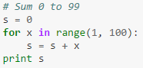

Slide 88
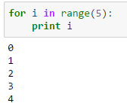
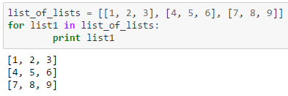

Slide 89
While loop Syntax:
while <condition>:
<code block>
continue
break
else:
<code block>

Slide 90
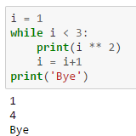
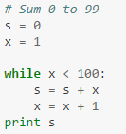

Slide 91
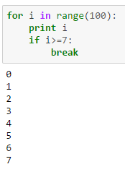
break: As the name says. It is used to break out of a loop when a condition becomes true when executing the loop.

Slide 92
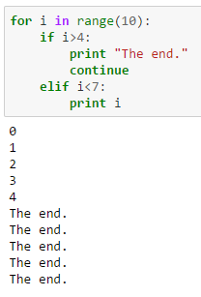
continue:This continues the rest of the loop. Sometimes when a condition is satisfied there are chances of the loop getting terminated. This can be avoided using continue statement.

Slide 93
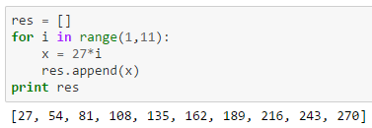
List generated by loop

Slide 94
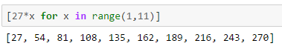
List generated by loop

Slide 95
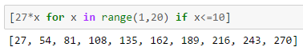
List generated by loop

Slide 96
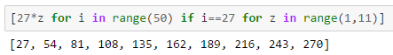
List generated by loop

Slide 97
Python: Functions

Slide 98
Functions
In math, you use functions: sine, cosine, …
In math, you define functions: f(x) = x² + 2x + 1
A function packages up and names a computation
Enables re-use of the computation (generalization)
Don’t Repeat Yourself (DRY principle)
Shorter, easier to understand, less error-prone
Python lets you use and define functions
We have already seen some Python functions:
len, float, int, str, range

Slide 99
len("hello") len("")
round(2.718) round(3.14)
pow(2, 3) range(1, 5)
math.sin(0) math.sin(math.pi / 2)
Some need no input: random.random()
All produce output
What happens if you forget the parentheses on a function call? random.random
Functions are values too
Types we know about:
int, float, str, bool, list, function

Slide 100
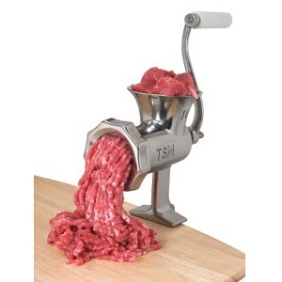
A function is a machine
You give it input
It produces a result
2
0
100
x
x
x
2x + 1
2x + 1
2x + 1
5
1
201
In math: func(x) = 2x + 1

Slide 101
x
Define the machine, including the input and the result
def dbl_plus(x):
return 2*x + 1
2x + 1
Name of the function. Like “y = 5” for a variable
Keyword that means: I am defining a function
Input variable name, or “formal parameter”
Keyword that means: This is the result
Return expression (part of the return statement)

Slide 102
Define the machine, including the input and the result
def square(x):
return x * x
def fahr_to_cent(fahr):
return (fahr – 32) / 9.0 * 5
def cent_to_fahr(cent):
result = cent / 5.0 * 9 + 32
return result
def abs(x):
if x < 0:
return – x
else:
return x
def print_hello():
print "Hello, world"
def print_fahr_to_cent(fahr):
result = fahr_to_cent(fahr)
print result
What is the result of:
x = 42
square(3) + square(4)
print x
boiling = fahr_to_cent(212)
cold = cent_to_fahr(-40)
print result
print abs(-22)
print print_fahr_to_cent(32)
No return statement
Returns the value None
Executed for side effect

Slide 103
Function definition
def square(x):
return x * x
square(3 + 4)
Function call or function invocation
Formal parameter (a variable)
Actual
argument
Current expression:
1 + square(3 + 4)
1 + square(7)
1 + 49
50
Variables:
x: 7
return x * x
return 7 * x
return 7 * 7
return 49
evaluate this expression
Evaluate the argument (at the call site)
Assign the actual argument’s value to the formal parameter name
A new variable, not reuse of any existing variable of the same name
Evaluate the statements in the body one by one
At a return statement:
Remember the value of the expression
Formal parameter variable disappears – exists only during the call!
The call expression evaluates to the return value

Slide 104
def square(x):
return x * x
Variables:
square(3) + square(4) (none)
return x * x x: 3
return 3 * x x: 3
return 3 * 3 x: 3
return 9 x: 3
9 + square(4) (none)
return x * x x: 4
return 4 * x x: 4
return 4 * 4 x: 4
return 16 x: 4
9 + 16 (none)
25 (none)

Slide 105
def fahr_to_cent(fahr):
return (fahr – 32) / 9.0 * 5
def cent_to_fahr(cent):
return cent / 5.0 * 9 + 32
Variables:
fahr_to_cent(cent_to_fahr(20)) (none)
return cent / 5.0 * 9 + 32 cent: 20
return 20 / 5.0 * 9 + 32 cent: 20
return 68 cent: 20
fahr_to_cent(68) (none)
return (fahr – 32) / 9.0 * 5 fahr: 68
return (68 – 32) / 9.0 * 5 fahr: 68
return 20 fahr: 68
20 (none)

Slide 106
def square(x):
return x * x
Variables:
square(square(3)) (none)
return x * x x: 3
return 3 * x x: 3
return 3 * 3 x: 3
return 9 x: 3
square(9) (none)
return x * x x: 9
return 9 * x x: 9
return 9 * 9 x: 9
return 81 x: 9
81 (none)

Slide 107
def square(z):
return z*z
def hypotenuse(x, y):
return math.sqrt(square(x) + square(y))
Variables:
hypotenuse(3, 4) (none)
return math.sqrt(square(x) + square(y)) x: 3 y:4
return math.sqrt(square(3) + square(y)) x: 3 y:4
return z*z z: 3 x: 3 y:4
return 3*3 z: 3 x: 3 y:4
return 9 z: 3 x: 3 y:4
return math.sqrt(9 + square(y)) x: 3 y:4
return math.sqrt(9 + square(4)) x: 3 y:4
return z*z z: 4 x: 3 y:4
return 4*4 z: 4 x: 3 y:4
return 16 z: 4 x: 3 y:4
return math.sqrt(9 + 16) x: 3 y:4
return math.sqrt(25) x: 3 y:4
return 5 x: 3 y:4
5 (none)

Slide 108
Same formal parameter name, but two completely different variables
def square(x):
return x*x
def hypotenuse(x, y):
return math.sqrt(square(x) + square(y))
Variables:
hypotenuse(3, 4) (none)
return math.sqrt(square(x) + square(y)) x: 3 y:4
return math.sqrt(square(3) + square(y)) x: 3 y:4
return x*x x: 3 x: 3 y:4
return 3*3 x: 3 x: 3 y:4
return 9 x: 3 x: 3 y:4
return math.sqrt(9 + square(y)) x: 3 y:4
return math.sqrt(9 + square(4)) x: 3 y:4
return x*x x: 4 x: 3 y:4
return 4*4 x: 4 x: 3 y:4
return 16 x: 4 x: 3 y:4
return math.sqrt(9 + 16) x: 3 y:4
return math.sqrt(25) x: 3 y:4
return 5 x: 3 y:4
5 (none)
Same formal parameter name
Formal parameter is a new variable

Slide 109
Same diagram, with variable scopes or environment frames shown explicitly
def square(x):
return x*x
def hypotenuse(x, y):
return math.sqrt(square(x) + square(y))
Variables:
hypotenuse(3, 4) (none) hypotenuse()
return math.sqrt(square(x) + square(y)) x: 3 y:4
return math.sqrt(square(3) + square(y)) square() x: 3 y:4
return x*x x: 3 x: 3 y:4
return 3*3 x: 3 x: 3 y:4
return 9 x: 3 x: 3 y:4
return math.sqrt(9 + square(y)) x: 3 y:4
return math.sqrt(9 + square(4)) square() x: 3 y:4
return x*x x: 4 x: 3 y:4
return 4*4 x: 4 x: 3 y:4
return 16 x: 4 x: 3 y:4
return math.sqrt(9 + 16) x: 3 y:4
return math.sqrt(25) x: 3 y:4
return 5 x: 3 y:4
5 (none)

Slide 110
stored = 0
def store_it(arg):
stored = arg
return stored
y = store_it(22)
print y
print stored
Show evaluation of the starred expressions:
y = store_it(22) store_it() stored: 0
stored = arg arg: 22 stored: 0
stored = 22 arg: 22 stored: 0
return stored arg: 22 stored: 22 stored: 0
return 22 arg: 22 stored: 22 stored: 0 y: 22
y = 22 stored: 0 y: 22
print stored stored: 0 y: 22
print 0
Variables:
Global or top level
Notes:
Prints 22, then 0

Slide 111
Idea: find the nearest variable of the given name
Check whether the variable is defined in the local scope
… check any intermediate scopes (none in CSE 160!) …
Check whether the variable is defined in the global scope
If a local and a global variable have the same name, the global variable is inaccessible (“shadowed”)
This is confusing; try to avoid such shadowing
x = 22
stored = 100
def lookup():
x = 42
return stored + x
lookup()
x = 5
stored = 200
lookup()
def lookup():
x = 42
return stored + x
x = 22
stored = 100
lookup()
x = 5
stored = 200
lookup()
What happens if we define stored after lookup?
Notes:
Answer: same result with code on the right-hand-side as on the left

Slide 112
def cent_to_fahr(cent):
result = cent / 5.0 * 9 + 32
return result
tempf = cent_to_fahr(15)
print result

Slide 113
myvar = 1
def outer():
myvar = 1000
return inner()
def inner():
return myvar
print outer()
Aside: The Evaluation Rules have a more precise rule, which applies when you define a function inside another function (which we will not be doing in this class).

Slide 114

Abstraction = ignore some details
Generalization = become usable in more contexts
Abstraction over computations:
functional abstraction, a.k.a. procedural abstraction
As long as you know what the function means, you don’t care how it computes that value
You don’t care about the implementation (the function body)

Slide 115
def abs(x):
if val < 0:
return -1 * val
else:
return 1 * val
def abs(x):
if val < 0:
return - val
else:
return val
def abs(x):
if val < 0:
result = - val
else:
result = val
return result
def abs(x):
return math.sqrt(x*x)

Slide 116
def round(x):
return int(x+0.5)
def round(x):
fraction = x - int(x)
if fraction >= .5:
return int(x) + 1
else:
return int(x)

Slide 117
Documentation for users/clients/callers
Document the purpose or meaning or abstraction that the function represents
Tells what the function does
Should be written for every function
Documentation for programmers who are reading the code
Document the implementation – specific code choices
Tells how the function does it
Only necessary for tricky or interesting bits of the code
def square(x):
"""Returns the square of its argument."""
# Uses "x*x" instead of "x**2"
return x*x
For users: a string as the first element of the function body
For programmers: arbitrary text after #

Slide 118
Multi-line strings
New way to write a string – surrounded by three quotes instead of just one
"hello"
'hello'
"""hello"""
'''hello'''
Any of these works for a documentation string
Triple-quote version:
can include newlines (carriage returns), so the string can span multiple lines
can include quotation marks

Slide 119
Don’t write useless comments
Comments should give information that is not apparent from the code
Here is a counter-productive comment that merely clutters the code, which makes the code harder to read:
# increment the value of x
x = x + 1
DO NOT write comments like this.

Slide 120
By convention, write a comment above the code that it describes (or, more rarely, on the same line)
First, a reader sees the English intuition or explanation, then the possibly-confusing code
# The following code is adapted from # “Introduction to Algorithms”, by Cormen et al., # section 14.22.
while (n > i):
...
A comment may appear anywhere in your program, including at the end of a line:
x = y + x # a comment about this line
For a line that starts with #, indentation should be consistent with surrounding code

Slide 121
def atm_to_mbar(pressure):
return pressure * 1013.25
def mbar_to_mmHg(pressure):
return pressure * 0.75006
# Confusing
pressure = 1.2 # in atmospheres
pressure = atm_to_mbar(pressure)
pressure = mbar_to_mmHg(pressure)
print pressure
# Better
in_atm = 1.2
in_mbar = atm_to_mbar(in_atm)
in_mmHg = mbar_to_mmHg(in_mbar)
print in_mmHg
# Best
def atm_to_mmHg(pressure):
in_mbar = atm_to_mbar(pressure)
in_mmHg = mbar_to_mmHg(in_mbar)
return in_mmHg
print atm_to_mmHg(1.2)
Corollary: Each variable should contain values of only one type
# Legal, but confusing: don’t do this!
x = 3
…
x = "hello"
…
x = [3, 1, 4, 1, 5]
…
If you use a descriptive variable name, you are unlikely to make these mistakes

Slide 122
def cent_to_fahr(cent):
print cent / 5.0 * 9 + 32
print cent_to_fahr(20)
def c_to_f(c):
print "c_to_f"
return c / 5.0 * 9 + 32
def make_message(temp):
print "make_message"
return ("The temperature is " + str(temp))
for tempc in [-40,0,37]:
tempf = c_to_f(tempc)
message = make_message(tempf)
print message
def myfunc(n):
total = 0
for i in range(n):
total = total + i
return total
print myfunc(4)
double(7)
abs(-20 - 2) + 20

Slide 123
def cent_to_fahr(cent):
print cent / 5.0 * 9 + 32
print cent_to_fahr(20)

Slide 124
def myfunc(n):
total = 0
for i in range(n):
total = total + i
return total
print myfunc(4)

Slide 125
def c_to_f(c):
print "c_to_f"
return c / 5.0 * 9 + 32
def make_message(temp):
print "make_message"
return "The temperature is " + str(temp)
for tempc in [-40,0,37]:
tempf = c_to_f(tempc)
message = make_message(tempf)
print message
c_to_f
make_message
The temperature is -40.0
c_to_f
make_message
The temperature is 32.0
c_to_f
make_message
The temperature is 98.6

Slide 126
Breaking down a program into functions is the fundamental activity of programming!
How do you decide when to use a function?
One rule: DRY (Don’t Repeat Yourself)
Whenever you are tempted to copy and paste code, don’t!
Now, how do you design a function?

Slide 127
How to design a function
1. Wishful thinking: Write the program as if the function already exists
2. Write a specification: Describe the inputs and output, including their types
No implementation yet!
3. Write tests: Example inputs and outputs
4. Write the function body (the implementation)
First, write your plan in English, then translate to Python
def fahr_to_cent(fahr):
"""Input: a number representing degrees Farenheit
Return value: a number representing degrees centigrade
"""
result = (fahr – 32) / 9.0 * 5
return result
assert fahr_to_cent(32) == 0
assert fahr_to_cent(212) == 100
assert fahr_to_cent(98.6) == 37
assert fahr_to_cent(-40) == -40
# Main program
tempf = 32
print "Temperature in Farenheit:", tempf
tempc = fahr_to_cent(tempf)
print "Temperature in Celsius:", tempc

Slide 128
Review: how to evaluate a function call
Evaluate the function and its arguments to values
If the function value is not a function, execution terminates with an error
Create a new stack frame
The parent frame is the one where the function is defined
In CSE 160, this is always the global frame
A frame has bindings from variables to values
Looking up a variable starts here
Proceeds to the next older frame if no match here
The oldest frame is the “global” frame
All the frames together are called the “environment”
Assignments happen here
Assign the actual argument values to the formal parameter variable
In the new stack frame
Evaluate the body
At a return statement, remember the value and exit
If at end of the body, return None
Remove the stack frame
The call evaluates to the returned value

Slide 129
def double(x):
return 2*x
def doubler():
return double
print double
myfns = [math.sqrt, int, double, math.cos]
print myfns[1](3.14)
print myfns[2](3.14)
print myfns[3](3.14)
print doubler()(2.718)
Notes:
myfns[1](3.14) is a function call, not a list dereference. But the function part is a list dereference.

Slide 130
Functions are blocks of code identified by a name, which can receive predetermined parameters.

Slide 131
In Python, functions:
Can return objects or not.
Accept Doc Strings.
Accept optional parameters (with defaults ). If no parameter is passed, it will be equal to the default defined in the function.
Accepts parameters to be passed by name. In this case, the order in which the parameters were passed does not matter.
Have their own namespace (local scope), and therefore may obscure definitions of global scope.
Can have their properties changed (usually by decorators).

Slide 132
Syntax:
def func(parameter1, parameter2=default_value):
"""
Doc String
"""
<code block>
return value

Slide 133
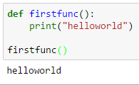
Example (hello world):

Slide 134

Example (return):

Slide 135

Example (multiple returns):

Slide 136

Example (function calls function):

Slide 137



Example (implicit arguments): When an argument of a function is common in majority of the cases or it is "implicit" this concept is used.

Slide 138

Example (any number of arguments):

Slide 139
Example (Global and Local Variables) Whatever variable is declared inside a function is local variable and outside the function in global variable.

Slide 140

Example (Global and Local Variables).

Slide 141

Example (Global and Local Variables).

Slide 142

Example (factorial with recursion):

Slide 143
Example (factorial with recursion):

Slide 144

Example (Fibonacci series with recursion):

Slide 145

Example (Fibonacci series without recursion):

Slide 146

Blocks

Slide 147
What is a list?
A list is an ordered sequence of values
What operations should a list support efficiently and conveniently?
Creation
Querying
Modification
3
1
4
4
5
9
“Four”
“score”
“and”
“seven”
“years”

Slide 148
List creation
a = [ 3, 1, 2*2, 1, 10/2, 10-1 ]
b = [ 5, 3, 'hi' ]
c = [ 4, 'a', a ]
d = [ [1, 2], [3, 4], [5, 6] ]
3
1
4
1
5
9
Notes:
>>> a = [ 3, 1, 2*2, 1, 10/2, 10-1 ]
>>> a
[3, 1, 4, 1, 5, 9]
>>> b = [ 5, 3, 'hi' ]
>>> b
[5, 3, 'hi']
>>> c = [4, 'a', a]
>>> c
[4, 'a', [3, 1, 4, 1, 5, 9]]

Slide 149
List Querying
Extracting part of the list:
Single element: mylist[index]
Sublist (“slicing”): mylist[startidx : endidx]
Find/lookup in a list
elt in mylist
Evaluates to a boolean value
mylist.index(x)
Return the int index in the list of the first item whose value is x. It is an error if there is no such item.
mylist.count(x)
Return the number of times x appears in the list.

Slide 150
List Modification
Insertion
Removal
Replacement
Rearrangement

Slide 151
List Insertion
mylist.append(x)
Extend the list by inserting x at the end
mylist.extend(L)
Extend the list by appending all the items in the argument list
mylist.insert(i, x)
Insert an item before the a given position.
a.insert(0, x) inserts at the front of the list
a.insert(len(a), x) is equivalent to a.append(x)
Notes:
You don’t have to memorize these. I’m just listing them to familiarize you with what is available, and then you can look in the documentation for details.

Slide 152
List Removal
mylist.remove(x)
Remove the first item from the list whose value is x
It is an error if there is no such item
mylist.pop([i])
Remove the item at the given position in the list, and return it.
If no index is specified, a.pop() removes and returns the last item in the list.
Notation from the Python Library Reference: The square brackets around the parameter, “[i]”, means the argument is optional.
It does not mean you should type square brackets at that position.

Slide 153
List Replacement
mylist[index] = newvalue
mylist[start:end] = newsublist
Can change the length of the list
mylist[start:end] = [] removes multiple elements
a[len(a):] = L is equivalent to a.extend(L)

Slide 154
List Rearrangement
list.sort()
Sort the items of the list, in place.
“in place” means by modifying the original list, not by creating a new list.
list.reverse()
Reverse the elements of the list, in place.

Slide 155
There are two new forms of expression:
[a, b, c, d] list creation
To evaluate:
evaluate each element to a value, from left to right
make a list of the values
The elements can be arbitrary values, including lists
["a", 3, 3.14*r*r, fahr_to_cent(-40), [3+4, 5*6]]
a[b] list indexing or dereferencing
To evaluate:
evaluate the list expression to a value
evaluate the index expression to a value
if the list value is not a list, execution terminates with an error
if the element is not in range (not a valid index), execution terminates with an error
the value is the given element of the list value (counting from zero)
Same tokens “[]” with two distinct meanings
List expression
Index expression

Slide 156
Exercise: list lookup
def index(somelist, value):
"""Return the position of the first occurrence of the element value in the list somelist. Return None if value does not appear in somelist."""
Examples:
gettysburg = ["four", "score", "and", "seven", "years", "ago"]
index(gettysburg, "and") => 2
index(gettysburg, "years") => 4
Fact: mylist[index(mylist, x)] == x

Slide 157
Exercise: list lookup (Answer)
def index(somelist, value):
"""Return the position of the first occurrence of the element value in the list somelist. Return None if value does not appear in somelist."""
i = 0
for c in somelist:
if c == value:
return i
i = i + 1
return None

Slide 158
Exercise: Convert Units
ctemps = [-40, 0, 20, 37, 100]
# Goal: set ftemps to [-40, 32, 68, 98.6, 212]
# Assume a function celsius_to_fahrenheit exists
ftemps = []
Notes:
Or
ftemps = [celsius_to_farenehit(c) for c in ctemps]

Slide 159
Exercise: Convert Units (Answer)
ctemps = [-40, 0, 20, 37, 100]
# Goal: set ftemps to [-40, 32, 68, 98.6, 212]
# Assume a function celsius_to_fahrenheit exists
ftemps = []
for c in ctemps:
f = celsius_to_farenheit(c)
ftemps.append(f)
Notes:
Or
ftemps = [celsius_to_farenehit(c) for c in ctemps]

Slide 160
List Slicing
mylist[startindex:endindex] evaluates to a sublist of the original list
mylist[index] evaluates to an element of the original list
Arguments are like those to the range function
mylist[start:end:step]
start index is inclusive, end index is exclusive
All 3 indices are optional
Can assign to a slice: mylist[s:e] = yourlist

Slide 161
List Slicing Examples
test_list = ['e0', 'e1', 'e2', 'e3', 'e4', 'e5', 'e6']
From e2 to the end of the list:
test_list[2:]
From beginning up to (but not including) e5:
test_list[:5]
Last element:
test_list[-1]
Last four elements:
test_list[-4:]
Everything except last three elements:
test_list[:-3]
Reverse the list:
test_list[::-1]
Get a copy of the whole list:
test_list[:]

